Slide 1
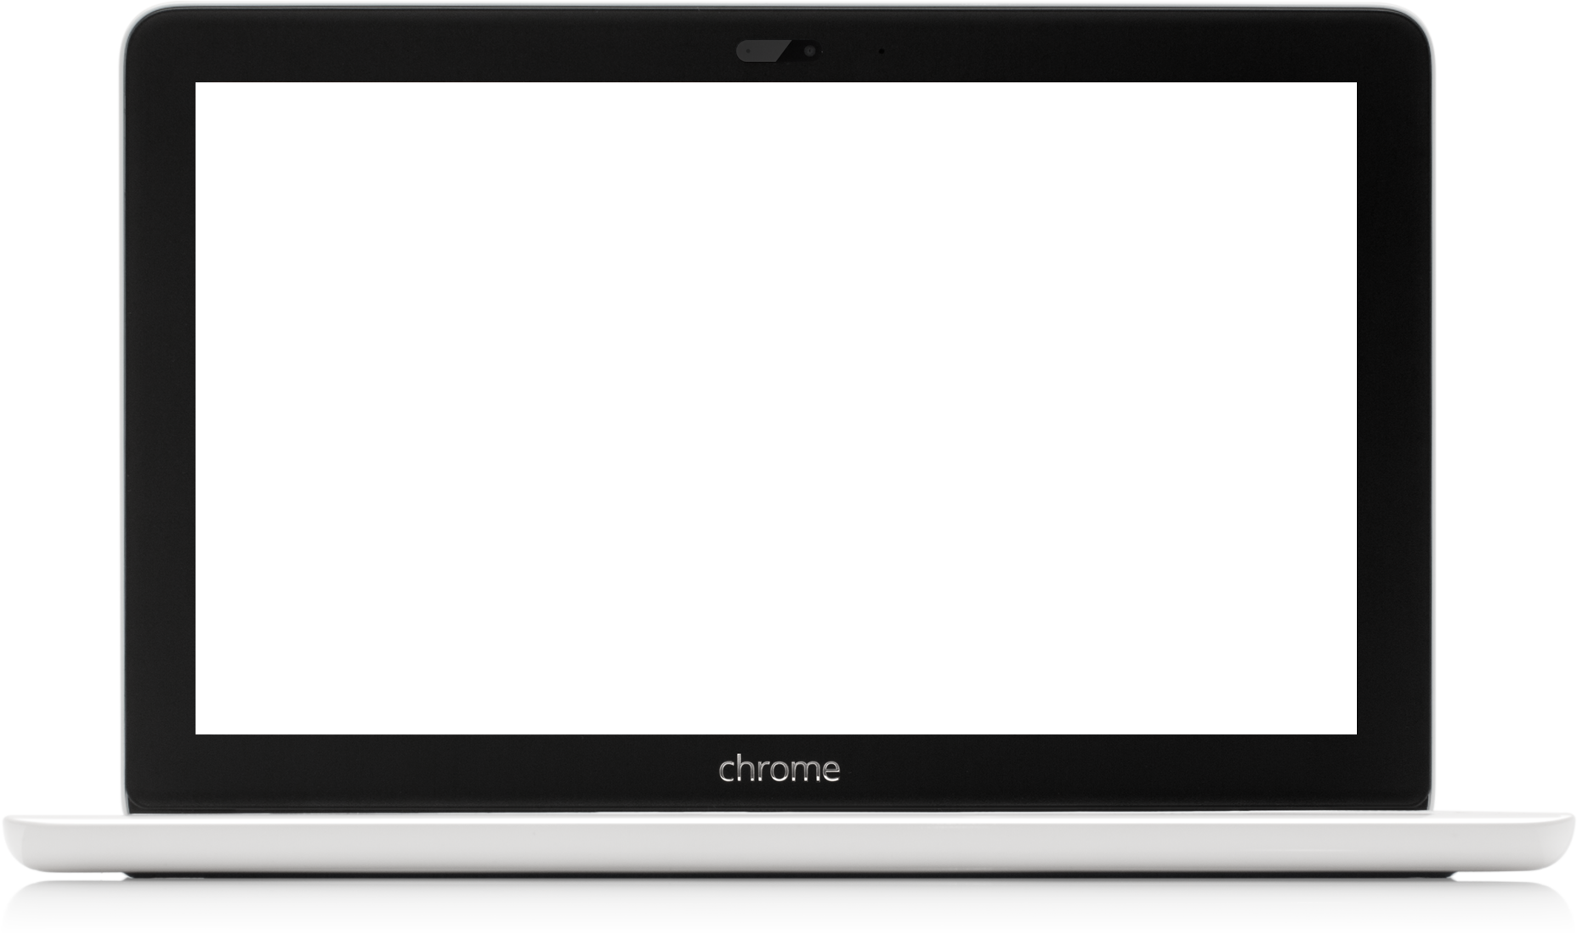
Ted
Krekoukis
Product Professional

Slide 2
Quicklinks
Product Experience
Project Experience
Team Building Experience
Contact

Slide 3
Product Experience
Barnes & Noble
NOOK
NOOK Senior Product Director, responsible for multi-million dollar e-commerce & retail business from 2011 to 2022
Roadmap owner, responsible for taking product inputs, analyzing, organizing and managing them into a strategic prioritized roadmap.
Oversee and Motivate all stages of product creation, including core teams and extended teams to achieve go-to market goals and manage the entire product life-cycle.
Responsible for global vendor relationships, negotiated contracts
Developed user stories using qualitative, quantitative and competitive analysis to determine best product fit. Participated in Scrum meetings & sprints.

Slide 4
Project Experience
Barnes & Noble
Conde Nast
IBM
Barnes & Noble
Project Managed launch of e-commerce, e-reading and listening product offerings, available on pre-installed android based devices, applications for iOS, android, and desktop software.
Oversee all Digital Audiobooks and Newsstand projects and priorities, implementing with design, software, QA and extended teams.
Conde Nast
Video Digital Asset Management System (DAMS) internal platform and customer facing video streaming solution, driving more views
IBM
Project managed the next iteration of IBM’s global project management tool, had over 3000 active projects & over 100,000 users.
Project managed the online implementation of global ad campaign with slogan “On Demand Business”

Slide 5
Team Building Experience
Barnes & Noble
Conde Nast
Barnes & Noble
Digital Newsstand and Audiobooks founding member, program owner.
Created a global team using in house hiring & vendor global footprint.
Conde Nast
Built and hired a co-location team responsible for project implementation, creative, front end production and quality control of advertiser campaigns

Slide 6
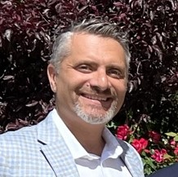
Contact
Information
Ted Krekoukis
Digital Professional
Email: tedkrek@icloud.com
Goal Focused, team player, who genuinely enjoys delivering solutions & products to customers, while adding value to the company.

